Slide 1
Predicting Wine Quality
A Logistic Regression Approach using Physiochemical Tests
Intro to Data Science: Capstone Project, November 2018
Krystle Lee

Slide 2
Project Overview
Objective
Background
Data Set Details
Data Wrangling
Exploratory Data Analysis
Analysis Approach
Model Evaluation and Metrics
Conclusion

Slide 3
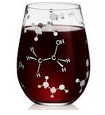
Objective: Use physiochemical tests to predict the quality of wine
Empower winemakers to make cost effective decisions
Give winemakers insight into their wine to make improvements
Quality of wine can determine the price point. Better quality can lead to more revenue.
Eliminate and reduce resource expenditures on wines that are predicted as bad quality
Repurpose bad quality wines by creating wine blends
Provide customers with a better wine experience
Give winemakers sense of pride in the product they are producing
Notes:
Image source: https://www.thinkgeek.com/images/products/frontsquare/jptr_ethanol_stemless_wine_glass.jpg

Slide 4
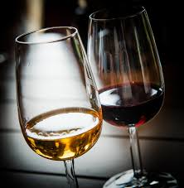
Background
Wine is produced through the process of turning grapes into wine by fermentation. Grapes are picked off the vines, fermented into alcohol and bottled. The longer the wine ages in the bottle tends to lead to a better wine.
There are many varieties of grapes and even more wines
Most wines that are scored by critics are given a score based on the 50-100 scale introduced by Robert M. Parker Jr.
5 Basic characteristics of wine:
Sweetness
Acidity
Tannin
Alcohol
Body

Slide 5
Wine Quality Data Set Data set from UCI Machine Learning Repository (Link)
Data Set Characteristics | Overall
Type | Portuguese "Vinho Verde"
Observations | 6,497 (Red: 1,599; White: 4,898)
Missing values | None
Attributes | 12 1 - fixed acidity 2 - volatile acidity 3 - citric acid 4 - residual sugar 5 - chlorides 6 - free sulfur dioxide 7 - total sulfur dioxide 8 - density | 9 - pH 10 - sulphates 11 - alcohol Output variable (based on sensory data): 12 - quality (score between 0 and 10)
Year Provided | 2009-10-07

Slide 6
Data Wrangling: Prepping the Data Set
Since no missing values in the data set, not much data wrangling was needed to be performed to get the data set ready for analysis
Red and white wines are appreciated for their different qualities and are therefore going to be kept as separate data sets to focus on physiochemical properties specific to the wine color
Wine quality rating was transformed into binary values to be used in a logistic regression analysis
Quality | Quality Rating | Binary Variable
Bad | 0 – 5 | 0
Good | 6 – 10 | 1

Slide 7
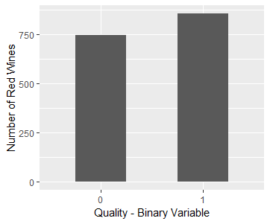
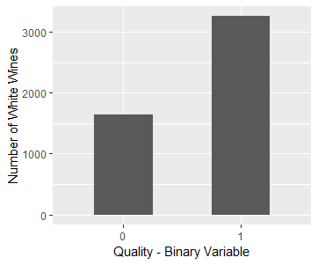
Exploratory Data Analysis: Taking a closer look
Bar charts
Red Wines
White Wines
855; 53%
3258; 67%
744; 47%
1640; 33%
Red wine data set is close to balanced
White wine data set has an imbalanced of good and bad quality wines
The red data set is more balanced than the white data set (e.g. in the red data set 53.4% are good quality, while in the white data set 66.5% are good quality). Handling data imbalance in the predictive model was not attempted in this project because imbalance was not severe. This is a topic that can be explored in future work.

Slide 8
Exploratory Data Analysis: Taking a closer look
Structure of Data Sets
> str(red)
'data.frame': 1599 obs. of 12 variables:
$ fixed.acidity : num 7.4 7.8 7.8 11.2 7.4 7.4 7.9 7.3 7.8 7.5 ...
$ volatile.acidity : num 0.7 0.88 0.76 0.28 0.7 0.66 0.6 0.65 0.58 0.5 ...
$ citric.acid : num 0 0 0.04 0.56 0 0 0.06 0 0.02 0.36 ...
$ residual.sugar : num 1.9 2.6 2.3 1.9 1.9 1.8 1.6 1.2 2 6.1 ...
$ chlorides : num 0.076 0.098 0.092 0.075 0.076 0.075 0.069 0.065 0.073 0.071 ...
$ free.sulfur.dioxide : num 11 25 15 17 11 13 15 15 9 17 ...
$ total.sulfur.dioxide: num 34 67 54 60 34 40 59 21 18 102 ...
$ density : num 0.998 0.997 0.997 0.998 0.998 ...
$ pH : num 3.51 3.2 3.26 3.16 3.51 3.51 3.3 3.39 3.36 3.35 ...
$ sulphates : num 0.56 0.68 0.65 0.58 0.56 0.56 0.46 0.47 0.57 0.8 ...
$ alcohol : num 9.4 9.8 9.8 9.8 9.4 9.4 9.4 10 9.5 10.5 ...
$ binary : num 0 0 0 1 0 0 0 1 1 0 ...
> str(white)
'data.frame': 4898 obs. of 12 variables:
$ fixed.acidity : num 7 6.3 8.1 7.2 7.2 8.1 6.2 7 6.3 8.1 ...
$ volatile.acidity : num 0.27 0.3 0.28 0.23 0.23 0.28 0.32 0.27 0.3 0.22 ...
$ citric.acid : num 0.36 0.34 0.4 0.32 0.32 0.4 0.16 0.36 0.34 0.43 ...
$ residual.sugar : num 20.7 1.6 6.9 8.5 8.5 6.9 7 20.7 1.6 1.5 ...
$ chlorides : num 0.045 0.049 0.05 0.058 0.058 0.05 0.045 0.045 0.049 0.044 ...
$ free.sulfur.dioxide : num 45 14 30 47 47 30 30 45 14 28 ...
$ total.sulfur.dioxide: num 170 132 97 186 186 97 136 170 132 129 ...
$ density : num 1.001 0.994 0.995 0.996 0.996 ...
$ pH : num 3 3.3 3.26 3.19 3.19 3.26 3.18 3 3.3 3.22 ...
$ sulphates : num 0.45 0.49 0.44 0.4 0.4 0.44 0.47 0.45 0.49 0.45 ...
$ alcohol : num 8.8 9.5 10.1 9.9 9.9 10.1 9.6 8.8 9.5 11 ...
$ binary : num 1 1 1 1 1 1 1 1 1 1 ...

Slide 9
Exploratory Data Analysis: Taking a closer look
Summary of Data Sets
Red Wine Summary | Min. | 1st Qu. | Median | Mean | 3rd Qu. | Max.
fixed.acidity | 4.6 | 7.1 | 7.9 | 8.32 | 9.2 | 15.9
volatile.acidity | 0.12 | 0.39 | 0.52 | 0.5278 | 0.64 | 1.58
citric.acid | 0 | 0.09 | 0.26 | 0.271 | 0.42 | 1
residual.sugar | 0.9 | 1.9 | 2.2 | 2.539 | 2.6 | 15.5
chlorides | 0.012 | 0.07 | 0.079 | 0.08747 | 0.09 | 0.611
free.sulfur.dioxide | 1 | 7 | 14 | 15.87 | 21 | 72
total.sulfur.dioxide | 6 | 22 | 38 | 46.47 | 62 | 289
density | 0.9901 | 0.9956 | 0.9968 | 0.9967 | 0.9978 | 1.0037
pH | 2.74 | 3.21 | 3.31 | 3.311 | 3.4 | 4.01
sulphates | 0.33 | 0.55 | 0.62 | 0.6581 | 0.73 | 2
alcohol | 8.4 | 9.5 | 10.2 | 10.42 | 11.1 | 14.9
binary | 0 | 0 | 1 | 0.5347 | 1 | 1
White Wine Summary | Min. | 1st Qu. | Median | Mean | 3rd Qu. | Max.
fixed.acidity | 3.8 | 6.3 | 6.8 | 6.855 | 7.3 | 14.2
volatile.acidity | 0.08 | 0.21 | 0.26 | 0.2782 | 0.32 | 1.1
citric.acid | 0 | 0.27 | 0.32 | 0.3342 | 0.39 | 1.66
residual.sugar | 0.6 | 1.7 | 5.2 | 6.391 | 9.9 | 65.8
chlorides | 0.009 | 0.036 | 0.043 | 0.04577 | 0.05 | 0.346
free.sulfur.dioxide | 2 | 23 | 34 | 35.31 | 46 | 289
total.sulfur.dioxide | 9 | 108 | 134 | 138.4 | 167 | 440
density | 0.9871 | 0.9917 | 0.9937 | 0.994 | 0.9961 | 1.039
pH | 2.72 | 3.09 | 3.18 | 3.188 | 3.28 | 3.82
sulphates | 0.22 | 0.41 | 0.47 | 0.4898 | 0.55 | 1.08
alcohol | 8 | 9.5 | 10.4 | 10.51 | 11.4 | 14.2
binary | 0 | 0 | 1 | 0.6652 | 1 | 1

Slide 10
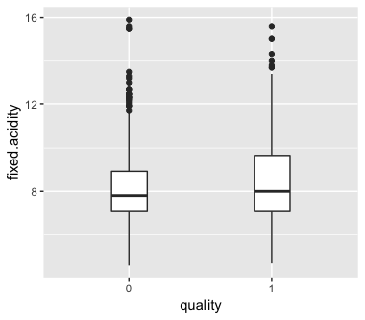
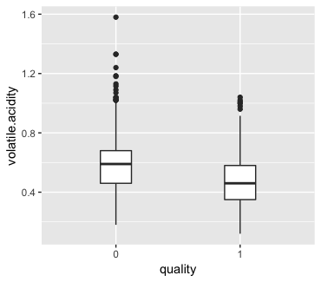
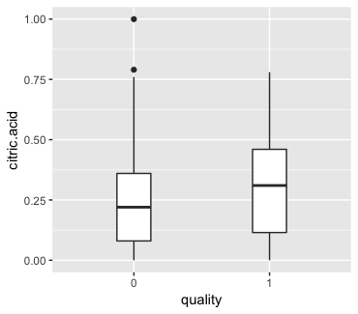
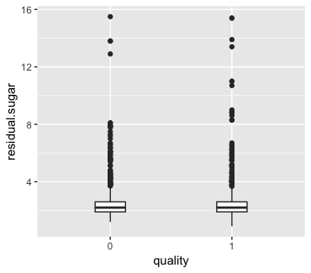
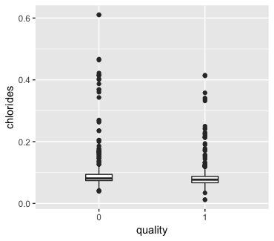
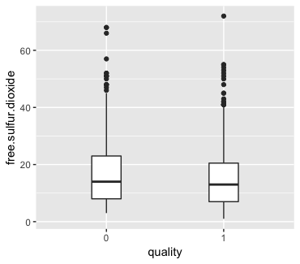
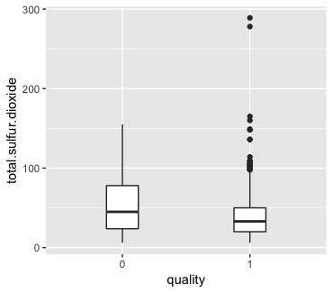
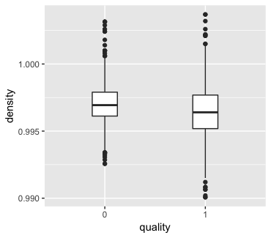
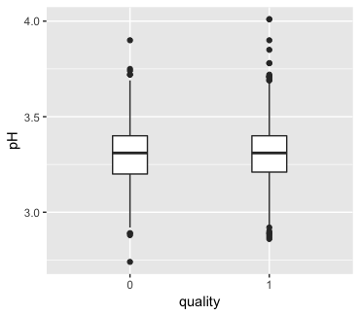
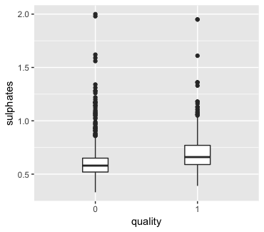
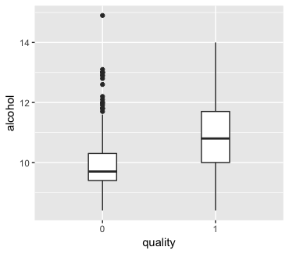
Exploratory Data Analysis: Taking a closer look
Red Wine Box Plots
Box plots show quality vs. variables provided in the data set. These boxplots provide an indication about the attributes that appear to be predictive of wine quality. Lower acidity and higher alcohol content seems to be associated with good quality wine.

Slide 11
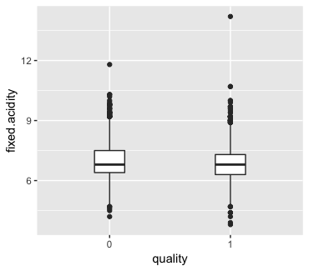
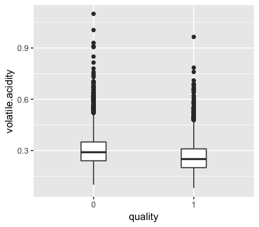
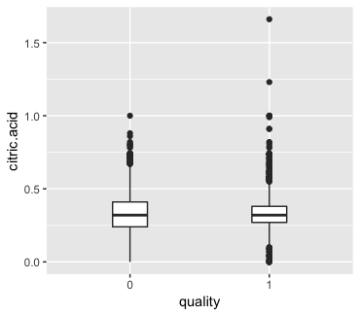
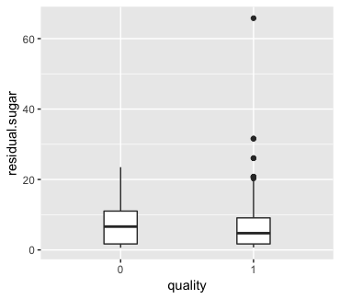
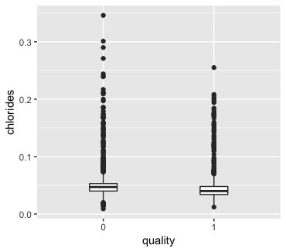
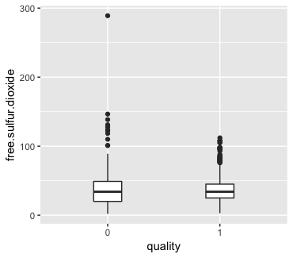
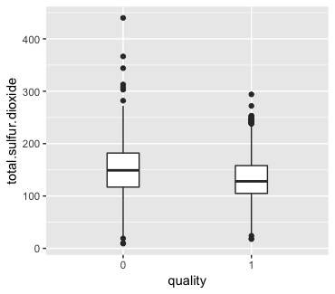
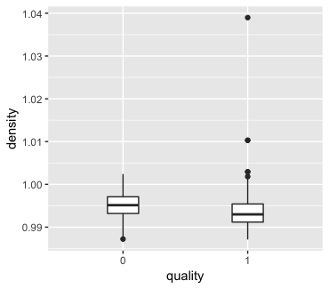
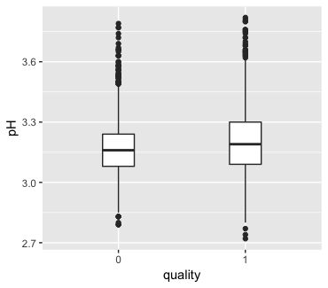
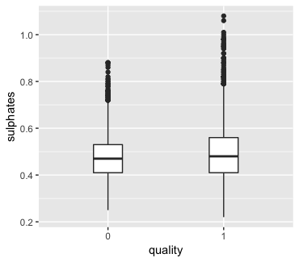
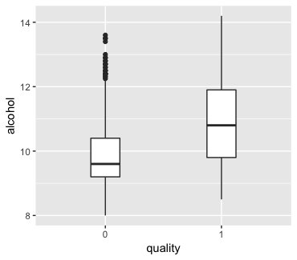
Exploratory Data Analysis: Taking a closer look
White Wine Box Plots
Box plots show quality vs. variables provided in the data set. These boxplots provide an indication about the attributes that appear to be predictive of wine quality. Lower acidity and higher alcohol content seems to be associated with good quality wine.

Slide 12
Exploratory Data Analysis: Taking a closer look
Red Wine Correlation Table
 | fixed.acidity | volatile.acidity | citric.acid | residual.sugar | chlorides | free.sulfur.dioxide | total.sulfur.dioxide | density | pH | sulphates | alcohol | binary
fixed.acidity | 1 | -0.26 | 0.67 | 0.11 | 0.09 | -0.15 | -0.11 | 0.67 | -0.68 | 0.18 | -0.06 | 0.10
volatile.acidity | -0.26 | 1 | -0.55 | 0.00 | 0.06 | -0.01 | 0.08 | 0.02 | 0.23 | -0.26 | -0.20 | -0.32
citric.acid | 0.67 | -0.55 | 1 | 0.14 | 0.20 | -0.06 | 0.04 | 0.36 | -0.54 | 0.31 | 0.11 | 0.16
residual.sugar | 0.11 | 0.00 | 0.14 | 1 | 0.06 | 0.19 | 0.20 | 0.36 | -0.09 | 0.01 | 0.04 | 0.00
chlorides | 0.09 | 0.06 | 0.20 | 0.06 | 1 | 0.01 | 0.05 | 0.20 | -0.27 | 0.37 | -0.22 | -0.11
free.sulfur.dioxide | -0.15 | -0.01 | -0.06 | 0.19 | 0.01 | 1 | 0.67 | -0.02 | 0.07 | 0.05 | -0.07 | -0.06
total.sulfur.dioxide | -0.11 | 0.08 | 0.04 | 0.20 | 0.05 | 0.67 | 1 | 0.07 | -0.07 | 0.04 | -0.21 | -0.23
density | 0.67 | 0.02 | 0.36 | 0.36 | 0.20 | -0.02 | 0.07 | 1 | -0.34 | 0.15 | -0.50 | -0.16
pH | -0.68 | 0.23 | -0.54 | -0.09 | -0.27 | 0.07 | -0.07 | -0.34 | 1 | -0.20 | 0.21 | 0.00
sulphates | 0.18 | -0.26 | 0.31 | 0.01 | 0.37 | 0.05 | 0.04 | 0.15 | -0.20 | 1 | 0.09 | 0.22
alcohol | -0.06 | -0.20 | 0.11 | 0.04 | -0.22 | -0.07 | -0.21 | -0.50 | 0.21 | 0.09 | 1 | 0.43
binary | 0.10 | -0.32 | 0.16 | 0.00 | -0.11 | -0.06 | -0.23 | -0.16 | 0.00 | 0.22 | 0.43 | 1
 | Excluded
 | -1 to - .5 & .5 to 1 Strongly correlated
 | -.5 to -.3 & .3 to .5 Moderately correlated
There is strong correlation between some of the physiochemical properties collected in the data. From the correlation estimates, lower volatile acidity and higher alcohol content leans toward a quality red wine.

Slide 13
Exploratory Data Analysis: Taking a closer look
White Wine Correlation Table
 | fixed.acidity | volatile.acidity | citric.acid | residual.sugar | chlorides | free.sulfur.dioxide | total.sulfur.dioxide | density | pH | sulphates | alcohol | binary
fixed.acidity | 1 | -0.02 | 0.29 | 0.09 | 0.02 | -0.05 | 0.09 | 0.27 | -0.43 | -0.02 | -0.12 | -0.09
volatile.acidity | -0.02 | 1 | -0.15 | 0.06 | 0.07 | -0.1 | 0.09 | 0.03 | -0.03 | -0.04 | 0.07 | -0.23
citric.acid | 0.29 | -0.15 | 1 | 0.09 | 0.11 | 0.09 | 0.12 | 0.15 | -0.16 | 0.06 | -0.08 | 0
residual.sugar | 0.09 | 0.06 | 0.09 | 1 | 0.09 | 0.3 | 0.4 | 0.84 | -0.19 | -0.03 | -0.45 | -0.09
chlorides | 0.02 | 0.07 | 0.11 | 0.09 | 1 | 0.1 | 0.2 | 0.26 | -0.09 | 0.02 | -0.36 | -0.18
free.sulfur.dioxide | -0.05 | -0.1 | 0.09 | 0.3 | 0.1 | 1 | 0.62 | 0.29 | 0 | 0.06 | -0.25 | 0
total.sulfur.dioxide | 0.09 | 0.09 | 0.12 | 0.4 | 0.2 | 0.62 | 1 | 0.53 | 0 | 0.13 | -0.45 | -0.17
density | 0.27 | 0.03 | 0.15 | 0.84 | 0.26 | 0.29 | 0.53 | 1 | -0.09 | 0.07 | -0.78 | -0.27
pH | -0.43 | -0.03 | -0.16 | -0.19 | -0.09 | 0 | 0 | -0.09 | 1 | 0.16 | 0.12 | 0.08
sulphates | -0.02 | -0.04 | 0.06 | -0.03 | 0.02 | 0.06 | 0.13 | 0.07 | 0.16 | 1 | -0.02 | 0.05
alcohol | -0.12 | 0.07 | -0.08 | -0.45 | -0.36 | -0.25 | -0.45 | -0.78 | 0.12 | -0.02 | 1 | 0.38
binary | -0.09 | -0.23 | 0 | -0.09 | -0.18 | 0 | -0.17 | -0.27 | 0.08 | 0.05 | 0.38 | 1
 | Excluded
 | -1 to - .5 & .5 to 1 Strongly correlated
 | -.5 to -.3 & .3 to .5 Moderately correlated
There is strong correlation between some of the physiochemical properties collected in the data. From the correlation estimates, higher alcohol content leans toward a quality white wine. A couple other variables to take notice are volatile acidity and density that are almost moderately correlated.

Slide 14
Analysis approach: Training and Testing Sets
Separating the data set into a training and testing set provides a way to evaluate the performance of the model when new observations are introduced
If the model is over fitted, it will perform well with the training set and poorly with the testing set.
For each wine color, the data was randomly split by the number of observations into a training (67%) and testing (33%)
Split method:
sample.split from caTools package
 | Training Set (67%) | Testing Set (33%) | Total Wines
Red | 1,071 | 528 | 1,599
White | 3,282 | 1,616 | 4,898

Slide 15
Analysis approach: glm model
Logistic Regression – All variables
Logistic Regression with Stepwise Method
With each training set, created a glm (generalized linear model) using all variables in the data set
Red:
glm(formula = binary ~ ., family = binomial, data = redrain)
White:
glm(formula = binary ~ ., family = binomial, data = whiteTrain)
Incorporated stepwise method to help identify the independent variables that attributed to a high performing model
Red:
glm(formula = binary ~ fixed.acidity + volatile.acidity + chlorides + free.sulfur.dioxide + total.sulfur.dioxide + sulphates + alcohol, family = binomial, data = redTrain)
White:
glm(formula = binary ~ volatile.acidity + residual.sugar + free.sulfur.dioxide + density + pH + sulphates + alcohol, family = binomial, data = whiteTrain)

Slide 16
Analysis approach (Red): Investigate glm summary
Analyzed the model using the summary function
Took note of each models AIC score and moved forward with the lowest
The low p-values in our model tells us which attributes are more significantly associated with wine quality
The positive and negative estimates for each attribute tells us how they impact the quality of the wine
RED GLM with all variables
RED GLM with stepwise method
Call:
glm(formula = binary ~ ., family = binomial, data = redTrain)
Deviance Residuals:
Min 1Q Median 3Q Max
-3.4731 -0.8624 0.3159 0.8308 2.1643
Coefficients:
 | Estimate | Std. Error | z value | Pr(>|z|)
(Intercept) | 1.29E+02 | 9.56E+01 | 1.351 | 0.1768
fixed.acidity | 2.04E-01 | 1.21E-01 | 1.691 | 0.09085 | .
volatile.acidity | -2.46E+00 | 5.58E-01 | -4.407 | 1.05E-05 | ***
citric.acid | -6.19E-01 | 6.61E-01 | -0.936 | 0.34909
residual.sugar | 7.36E-02 | 6.73E-02 | 1.095 | 0.2736
chlorides | -3.54E+00 | 1.91E+00 | -1.847 | 0.06468 | .
free.sulfur.dioxide | 1.31E-02 | 9.93E-03 | 1.315 | 0.18846
total.sulfur.dioxide | -1.21E-02 | 3.35E-03 | -3.599 | 0.00032 | ***
density | -1.40E+02 | 9.76E+01 | -1.435 | 0.15136
pH | 2.08E-01 | 8.70E-01 | 0.239 | 0.81148
sulphates | 2.76E+00 | 5.52E-01 | 5.001 | 5.71E-07 | ***
alcohol | 8.11E-01 | 1.25E-01 | 6.508 | 7.64E-11 | ***
---
Signif. codes: 0 ‘***’ 0.001 ‘**’ 0.01 ‘*’ 0.05 ‘.’ 0.1 ‘ ’ 1
(Dispersion parameter for binomial family taken to be 1)
Null deviance: 1479.5 on 1070 degrees of freedom
Residual deviance: 1127.7 on 1059 degrees of freedom
AIC: 1151.7
Number of Fisher Scoring iterations: 4
Call:
glm(formula = binary ~ fixed.acidity + volatile.acidity + chlorides +
free.sulfur.dioxide + total.sulfur.dioxide + sulphates +
alcohol, family = binomial, data = redTrain)
Deviance Residuals:
Min 1Q Median 3Q Max
-3.2958 -0.8542 0.3242 0.8383 2.2209
Coefficients:
 | Estimate | Std. Error | z value | Pr(>|z|)
(Intercept) | -9.608401 | 1.098417 | -8.747 | < 2e-16 | ***
fixed.acidity | 0.063392 | 0.044532 | 1.424 | 0.155
volatile.acidity | -2.330716 | 0.453931 | -5.135 | 2.83E-07 | ***
chlorides | -3.925939 | 1.72687 | -2.273 | 0.023 | *
free.sulfur.dioxide | 0.014464 | 0.009622 | 1.503 | 0.133
total.sulfur.dioxide | -0.012346 | 0.003021 | -4.086 | 4.39E-05 | ***
sulphates | 2.536938 | 0.526708 | 4.817 | 1.46E-06 | ***
alcohol | 0.917475 | 0.085443 | 10.738 | < 2e-16 | ***
---
Signif. codes: 0 ‘***’ 0.001 ‘**’ 0.01 ‘*’ 0.05 ‘.’ 0.1 ‘ ’ 1
(Dispersion parameter for binomial family taken to be 1)
Null deviance: 1479.5 on 1070 degrees of freedom
Residual deviance: 1131.1 on 1063 degrees of freedom
AIC: 1147.1
Number of Fisher Scoring iterations: 4
Move forward with GLM using stepwise method due to lower AIC value

Slide 17
Analysis approach (White): Investigate glm summary
Analyzed the model using the summary function
Took note of each models AIC score and moved forward with the lowest
The low p-values in our model tells us which attributes are more significantly associated with wine quality
The positive and negative estimates for each attribute tells us how they impact the quality of the wine
WHITE GLM with all variables
WHITE GLM with stepwise method
Call:
glm(formula = binary ~ ., family = binomial, data = whiteTrain)
Deviance Residuals:
Min 1Q Median 3Q Max
-2.6902 -0.8957 0.4440 0.7977 2.5535
Coefficients:
 | Estimate | Std. Error | z value | Pr(>|z|)
(Intercept) | 3.91E+02 | 9.08E+01 | 4.3 | 1.71E-05 | ***
fixed.acidity | 7.80E-02 | 8.89E-02 | 0.878 | 3.80E-01
volatile.acidity | -6.39E+00 | 5.13E-01 | -12.439 | <2.00E-16 | ***
citric.acid | 3.77E-01 | 3.65E-01 | 1.034 | 3.01E-01
residual.sugar | 2.06E-01 | 3.41E-02 | 6.036 | 1.58E-09 | ***
chlorides | 9.27E-01 | 2.06E+00 | 0.451 | 6.52E-01
free.sulfur.dioxide | 8.97E-03 | 3.43E-03 | 2.616 | 0.00889 | **
total.sulfur.dioxide | -1.33E-03 | 1.48E-03 | -0.897 | 3.70E-01
density | -4.04E+02 | 9.20E+01 | -4.385 | 1.16E-05 | ***
pH | 1.34E+00 | 4.48E-01 | 2.993 | 0.00277 | **
sulphates | 2.32E+00 | 4.47E-01 | 5.192 | 2.08E-07 | ***
alcohol | 5.43E-01 | 1.18E-01 | 4.598 | 4.26E-06 | ***
---
Signif. codes: 0 ‘***’ 0.001 ‘**’ 0.01 ‘*’ 0.05 ‘.’ 0.1 ‘ ’ 1
(Dispersion parameter for binomial family taken to be 1)
Null deviance: 4185.0 on 3281 degrees of freedom
Residual deviance: 3309.2 on 3270 degrees of freedom
AIC: 3333.2
Number of Fisher Scoring iterations: 5
Call:
glm(formula = binary ~ volatile.acidity + residual.sugar + free.sulfur.dioxide +
density + pH + sulphates + alcohol, family = binomial, data = whiteTrain)
Deviance Residuals:
Min 1Q Median 3Q Max
-2.6893 -0.9029 0.4432 0.8029 2.5434
Coefficients:
 | Estimate | Std. Error | z value | Pr(>|z|)
(Intercept) | 3.29E+02 | 5.59E+01 | 5.873 | 4.28E-09 | ***
volatile.acidity | -6.60E+00 | 4.95E-01 | -13.337 | <2.00E-16 | ***
residual.sugar | 1.82E-01 | 2.24E-02 | 8.117 | 4.78E-16 | ***
free.sulfur.dioxide | 7.35E-03 | 2.74E-03 | 2.679 | 0.00739 | **
density | -3.40E+02 | 5.60E+01 | -6.067 | 1.30E-09 | ***
pH | 9.67E-01 | 3.13E-01 | 3.093 | 0.00198 | **
sulphates | 2.20E+00 | 4.34E-01 | 5.074 | 3.90E-07 | ***
alcohol | 6.25E-01 | 8.23E-02 | 7.593 | 3.13E-14 | ***
---
Signif. codes: 0 ‘***’ 0.001 ‘**’ 0.01 ‘*’ 0.05 ‘.’ 0.1 ‘ ’ 1
(Dispersion parameter for binomial family taken to be 1)
Null deviance: 4185.0 on 3281 degrees of freedom
Residual deviance: 3312.4 on 3274 degrees of freedom
AIC: 3328.4
Number of Fisher Scoring iterations: 5
Move forward with GLM using stepwise method due to lower AIC value

Slide 18
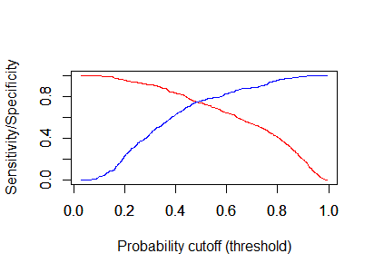
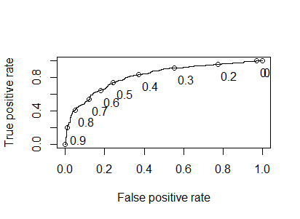
Model Evaluation and Metrics (Red Training Set): Predicted values, average probabilities, confusion matrix, ROCR, AUC
Created prediction model and identified average probability of bad and good quality wines
Range of predicted probabilities
Min. | 1st Qu. | Median | Mean | 3rd Qu. | Max.
0.02852 | 0.29656 | 0.51166 | 0.53501 | 0.79278 | 0.99562
Sensitivity (red line) vs
Specificity (blue line)
Area Under the Curve (AUC) = 81.4%
Average predicted probabilities of each quality
0 | 1
0.378402 | 0.671127
Confusion matrix using >50% as threshold value
 | FALSE | TRUE
0 | 377 | 121
1 | 150 | 423
Sensitivity | 74%
Specificity | 76%
Accuracy | 75%

Slide 19

Model Evaluation and Metrics (Red Testing Set): How does training model do against testing data set?
Apply prediction model from training set to testing to see how well it does on new observations
Range of predicted probabilities
Min. | 1st Qu. | Median | Mean | 3rd Qu. | Max.
0.02688 | 0.28701 | 0.51637 | 0.52566 | 0.77709 | 0.98596
Sensitivity (red line) vs
Specificity (blue line)
Area Under the Curve (AUC) = 82.8%
Average predicted probabilities of each quality
0 | 1
0.3650934 | 0.6657357
Confusion matrix using >50% as threshold value
 | FALSE | TRUE
0 | 181 | 65
1 | 71 | 211
Sensitivity | 73%
Specificity | 74%
Accuracy | 73%
All rates went down when applying test set but by less than 2%

Slide 20
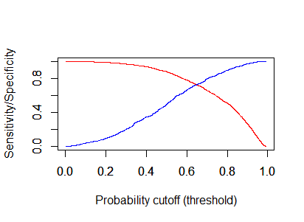
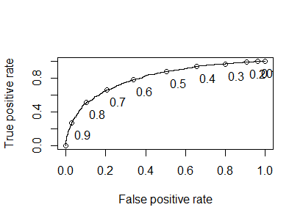
Model Evaluation and Metrics (White Training Set): Predicted values, average probabilities, confusion matrix, ROCR, AUC
Created prediction model and identified average probability of bad and good quality wines
Range of predicted probabilities
Min. | 1st Qu. | Median | Mean | 3rd Qu. | Max.
0.002416 | 0.502754 | 0.705134 | 0.665143 | 0.86871 | 0.992237
Sensitivity (red line) vs
Specificity (blue line)
Area Under the Curve (AUC) = 80%
Average predicted probabilities of each quality
0 | 1
0.5011334 | 0.7477116
Confusion matrix using >50% as threshold value
 | FALSE | TRUE
0 | 543 | 556
1 | 267 | 1916
Sensitivity | 88%
Specificity | 49%
Accuracy | 75%

Slide 21
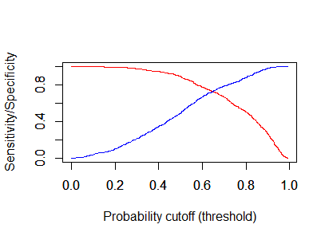
Model Evaluation and Metrics (White Testing Set): How does training model do against testing data set?
Apply prediction model from training set to testing to see how well it does on new observations
Range of predicted probabilities
Min. | 1st Qu. | Median | Mean | 3rd Qu. | Max.
0.0009725 | 0.5063071 | 0.71176 | 0.6657905 | 0.8660665 | 0.9926941
Sensitivity (red line) vs
Specificity (blue line)
Area Under the Curve (AUC) = 80.2%
Average predicted probabilities of each quality
0 | 1
0.4997906 | 0.7493309
Confusion matrix using >50% as threshold value
 | FALSE | TRUE
0 | 264 | 277
1 | 118 | 957
Sensitivity | 89%
Specificity | 49%
Accuracy | 76%
Sensitivity and accuracy rates improved slightly when applying test set

Slide 22
Conclusion
Some examples of the physiochemical properties that impact the quality of wine:
Sweetness – Residual Sugar (High) (White)
Acidity – Fixed Acidity(High) (Red), Volatile Acidity (Low)(Both)
Alcohol - High(Both)
With this prediction model, winemakers will have a better understanding of their wines
If predicted quality leans toward bad quality wine, winemakers can repurpose their wines creating new wines by blending to balance out the variables that are too high or low
They can also use this analysis as a starting point for further research into what causes the high and low physiochemical results that have the most significant impact on wine quality
Good quality wines tend to show below physiochemical values
 | Red Wine | White Wine
(Intercept) | -9.608401 | 3.29E+02
fixed.acidity | 0.063392
volatile.acidity | -2.330716 | -6.60E+00
citric.acid
residual.sugar |  | 1.82E-01
chlorides | -3.925939
free.sulfur.dioxide | 0.014464 | 7.35E-03
total.sulfur.dioxide | -0.012346
density |  | -3.40E+02
pH |  | 9.67E-01
sulphates | 2.536938 | 2.20E+00
alcohol | 0.917475 | 6.25E-01
fixed.acidity
chlorides
total.sulfur.dioxide
Red
Both
volatile.acidity
free.sulfur.dioxide
sulphates
alcohol
White
residual.sugar
density
pH

Slide 23
Sources
UCI Machine Learning Repository
5 Stages of the Wine Making Process
Wine Characteristics
Winemaking
Image: Wine

